Slide 1
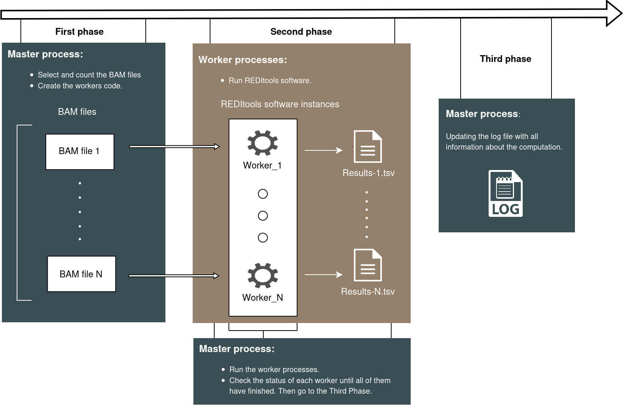

Slide 2




FIRST PHASE
SECOND PHASE
THIRD PHASE
Master process:
Select and count the BAM files
Create the workes code
Worker process:
Run REDItools software
REDItools software instance
Master process:
Updating the log file with all information about the computation
BAM file 1
Worker 1
Result 1
BAM file n
Worker n
Result n
Master process:
Run the worker processes
Check the status of each worker until all of the, have finished. Then go to the Third Phase

Slide 3
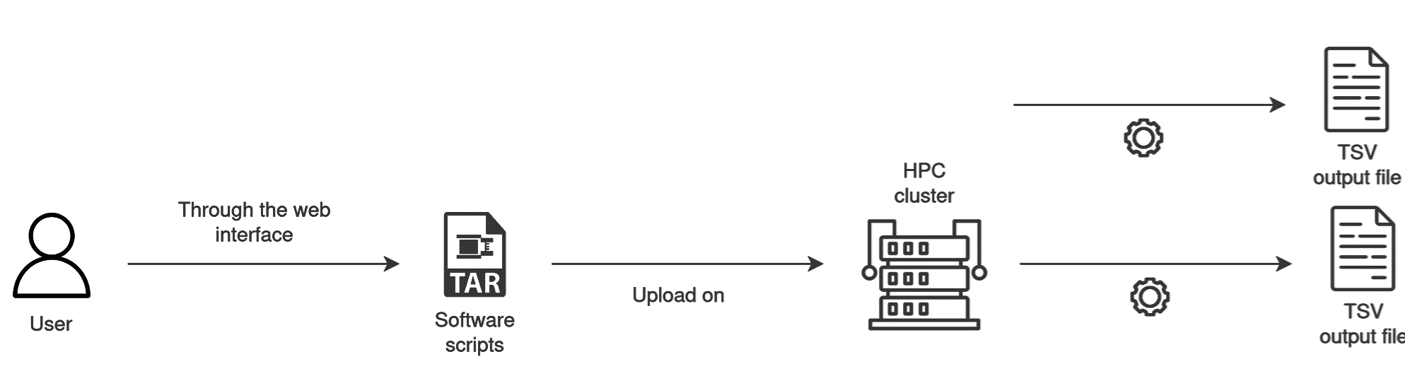

Slide 4






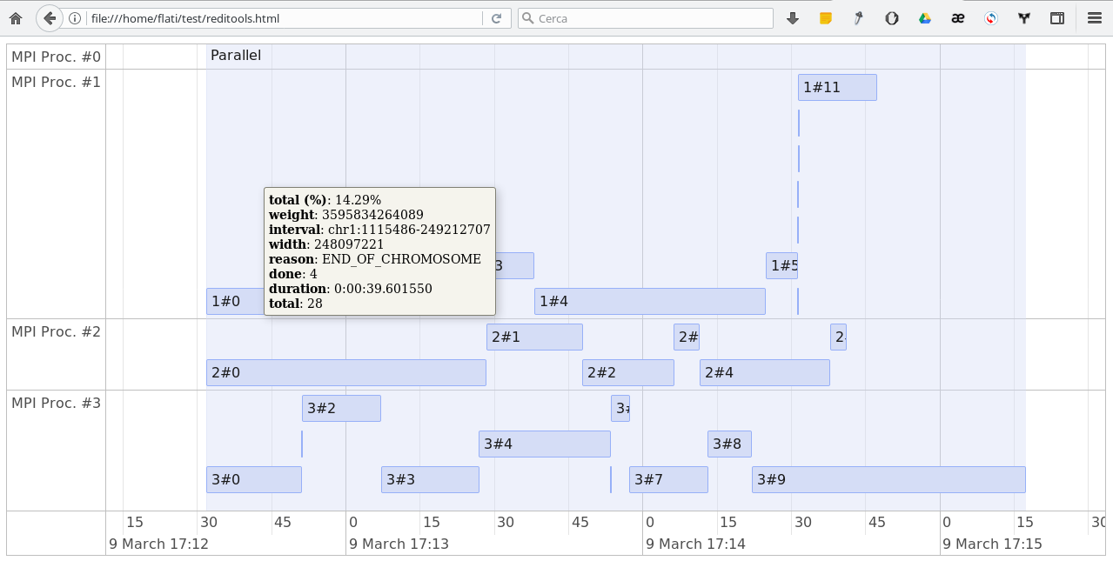
execute
start.sh
through the web interface
upload on
result
User
Software scripts
Output (TSV file)
HPC Cluster
download to
upload the files
on the
Personal Computer
Input (BAM files)
post-processing phase

